Slide 1


Concepts Consulting RFP Response for
DropMusic Mobile App MVP
Aug 09, 2021

Slide 2
Table of Content
01
Our Understanding
02
Discovery Process
Program Objectives & MVP Scope
High level details of Approach and Discovery Process
03
04
Pricing
Solution View
Tenet of Solution, Architecture Blueprint
Team Structure, Pricing and Indicative Schedule

Slide 3
Our understanding of project objectives:
A mobile app that enhances and improves upon the existing capabilities of Spotify and YouTube for discovering new music covers and cover artists.
Enhance the user experience of music listeners and cover music creators to discover new and compelling music from established and upcoming artists via a compelling user interface
Ability to scale and expand beyond simple discovery and listening experiences as needed
Ability for basic advertisement capability for revenue generation and for basic analytics for usage and user analytics.

Slide 4
Features:
Curated music from YouTube and Spotify
Elastic Search
Embedded music player (YT & SPT)
Preferences such as Language and Genre
Favourites
Playlists
Feedback System
Push Notification
Accessibility
Social sharing
Advertisement
Subscription based content
Share/Reference model
Primary Content
Preferences
Artifacts
Revenue Model
DropMusic

Slide 5
Program Scope: Mobile Application
User Research
Requirement Gathering & Understanding
Architecture and Design
Project Planning
Prototyping & Wireframe
UI / UX Flow Development
Ads & Analytics integration
Authentication & Authorization
Core App Development
API Integration
Push Notification
Social Sharing
Build Deployment
Unit/Functional Testing(Manual)
Cross Device Testing
UAT Support
Go-Live & Warranty support
Strategy
Mockups
Development
Testing
DropMusic

Slide 6

Discovery Process

Slide 7
Mindset towards solving the problem
Utilize Design Thinking Principles and our Three-Phased Approach
to create maximum impact
Discovery
Problem Validation
02
03
Design
Concept Validation
01
03
01
Business
Build
Experience
Product Validation
Experience
Experience
Technology
Technology
Understand
Ideate
Accelerate
Technology
Deploy
Market Validation
CONSUMER CENTRIC | SIMPLE | GUIDED | RELIABLE | OMNICHANNEL

Slide 8
As a way to achieve..
Elevate the User Experience for all..
Partner Ecosystem
Departments
Cleaner Data
Connected Communication
Consistent View
Elevated User Experience
Staff/
Associates
Individuals/
Families/ Members/
Donors
Landscape View: Parties Involved in communication
GETTING CLOSER TO CONSUMER…

Slide 9
Solution View

Slide 10
Tenets of our solution (Template)
Set stage for cleaner data, governance, processes and seamless omnichannel communication
Create Platform & Services, Technology Foundation for scaling
MVP - Address immediate needs and utilize the existing investments made.
User Centric Solution, Persona based features and transmit the data back to source systems for consistent view.

Slide 11


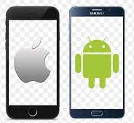


System Architecture: High Level Diagram
Server Side Architecture
DynamoDB
AWS Lambda
Mobile Client
AWS Elastic Search
AWS API Gateway

Slide 12
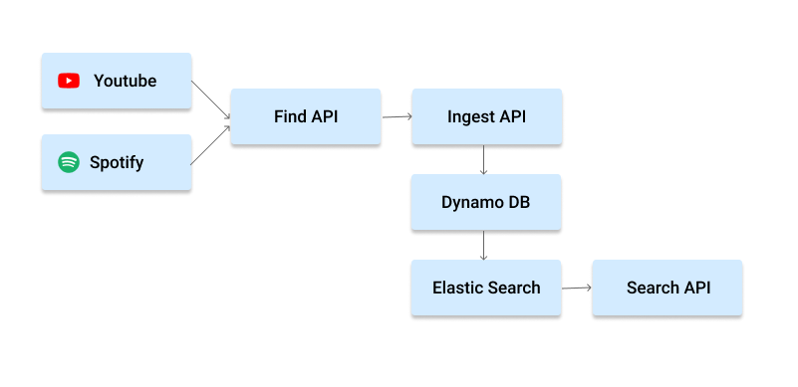
Server Architecture:
AWS API Gateway

Slide 13
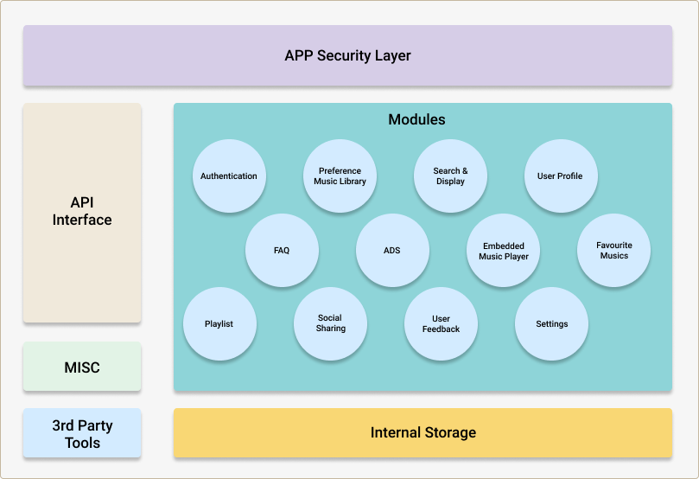
Client
Architecture:
AWS API Gateway

Slide 14
Team, Pricing & Schedule

Slide 15
Team Structure: Estimation
Activity | Resource Count (Details) | Estimated HRs
DynamoDB (Planning, Designing, Implementation) | 1 | 24hrs (8hrs/day)
AWS lambda programmer (Planning, Designing, Implementation, unit Testing) | 2(1 Senior developer+1 Junior developer) | 160 hrs (8hrs/day)
Flutter developer (Planning, Designing, Implementation, unit Testing) | 2(1 Senior developer+1 junior developer) | 360hrs (8hrs/day)
Flutter UI/UX developer (Planning, Designing, Implementation) | 1 | 128hrs (8hrs/day)
Integration and testing | 1 | 40hrs (8hrs/day)
App Testing(manual) | 1 | 40hrs (8hrs/day)
TOTAL | 6 | 752 hours

Slide 16
Pricing: Estimation

Slide 17
Key Assumptions
Software Licensing and cloud infrastructure cost will be owned by DropMusic
All the required APIs from the backend will be provided
Stretch goals requirements are not part of the scope and estimation
Privacy Policy and legislations requirement will be owned by _____________
Data Security and encryption requirement will be owned by ______________
Sprint Demo
Project Launch / Go Live

Slide 18
Q&A
Spotify subscription is required to access through developer account? DropMusic Subscription on top of the Spotify Subscription. That’s right! What are the roles of Product management and Product owner? Work with Product Owner and cascade the requirement to the team What are the different activities involved in Copy writing? Limited to the language inside the app (Labels) Push Notifications – Does once user can login using the same credentials in multiple devices Open for single device login / multiple device login, depends on our recommendation for the MVP. To Confirm, No streaming performed by Drop Music directly, correct? That’s right! Embedded Spotify Audio and YouTube Video Player using their respective libraries ? Spotify doesn’t have out of the box support for React native. Can be used only through tweaking the Android base code Open for our recommendation based on what’s best for MVP. What kind on Interstitial ads are used in the app, Any sample reference ? Any overlap on YouTube ads/Drop Music ads Ad content insertion between YT and Spotify music. Pre-roll and Post-roll ad is not feasible with embed player. Is the user allowed to create tags, or is this managed in the backend? Managed in the backend by editorial team Share Invitation via share social platform, Is it something like sharing a URL with an invitation id? This needs to be further discussed during the discovery phase. What are the platform to be shared (Facebook, Instagram, Tok-tok?) For MVP, only FB, Twitter and Instagram are in scope. Privacy standards and Legislation details? Focus for California standards DevOps available for automated build process? For backend, Git Actions are used and we can use Git Actions or CircleCI as per our recommendation. Testing the mobile app using BrowserStack? Yes, testing using cloud based virtual device testing is sufficient for MVP

Slide 19
Other points discussed
DM will be a layer app on top of Spotify or Youtube. Subscriptions should be owned by users who installs DM in his device. Currently there are no requirements for streaming the content directly in DM app. All streaming will be done from either Spotify or Youtube players.
Technology of Choice - Vendor who proivdes solution should propose right technology for this. React native or Flutter may be a technology of choice.
Product Management requirment to be filled by CSQ and Prodcut owners will be fullfilled by Krys and his team.
Copy writing - App textual and other resoures should be verified and owned by DM team.
Push notifications of same user logins in multiple devices - this can be explored and implemented if this is feasible within MVP time otherwise not a priority item.
Options for Ad Server and Ad platform should be proposed by Vendor team.
Sharing To social media - Immediate target is to share on Facebook, Whatsapp, Instagram and TikTok. What content and other Deep linking requirements are to be discussed further during discovery phase.
This app is immediately going to be targeted to US market. California level Privacy requirements are fine for MVP.
Scope of Backend development is not much for current MVP. Vendor team should support DM for all other requirements such App Development, Testing, DevOps and other Product Phases.
Tag Creation by users is not finalized yet. Playlist creation by users is still in the list.
Ad positioning requirements -

Slide 20

Thank You!

